Slide 1
Capstone Project - 4
Netflix Movies And TV Shows Clustering
Unsupervised Machine Learning
Project by : Debashish Das Lucky Jain Vivek Katolkar

Slide 2
Table Of Contents
Defining problem statement
Data Cleaning & visualization
Data Preprocessing
Feature Selection
Applying different clustering methods
Applying Clustering Models
Conclusion

Slide 3

Problem Statement
This dataset consists of tv shows and movies available on Netﬂix as of 2019. The dataset is collected from Flixable which is a third-party Netﬂix search engine.
In 2018, they released an interesting report which shows that the number of TV shows on Netﬂix has nearly tripled since 2010. The streaming service’s number of movies has decreased by more than 2,000 titles since 2010, while its number of TV shows has nearly tripled. It will be interesting to explore what all other insights can be obtained from the same dataset.

Slide 4
Data Summary
show_id : Unique ID for every Movie / Tv Show
type : A Movie or TV Show
title : Title of the Movie / Tv Show
director : Director of the Movie
cast : Actors involved in the movie / show
country : Country where the movie / show was produced
date_added : Date it was added on Netﬂix
release_year : Actual Release year of the movie / show
rating : TV Rating of the movie / show
duration : Total Duration - in minutes or number of seasons
listed_in : Generes
description: The Summary description

Slide 5
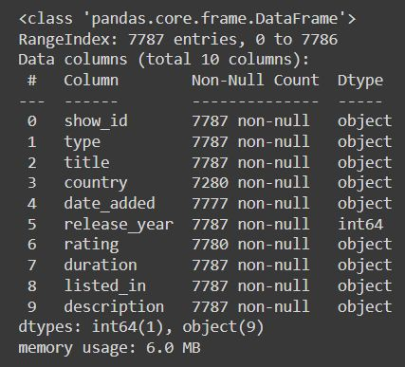
Basic Data Exploration
The dataset has 7787 observations and 12 features(columns).
The dataset consists of eleven textual columns and one numeric column(‘release_year’ )
No Duplicate values.

Slide 6
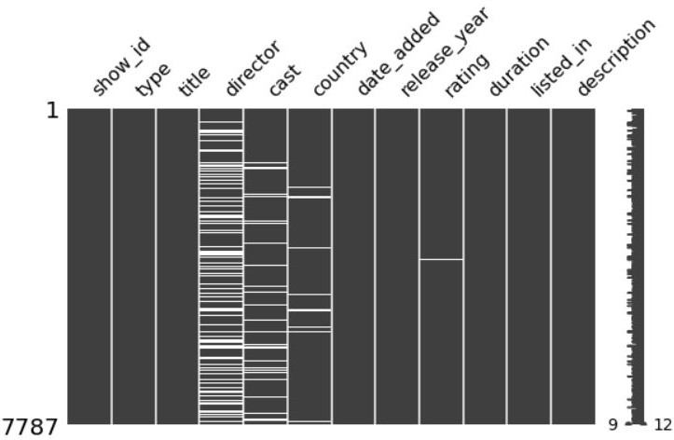
EDA (Checking NAN Values)
Null values present in this columns
director
cast
country
Rating
No missing value present in this columns
show_id
type
title
date_added
release_year
duration
listed_in
description

Slide 7
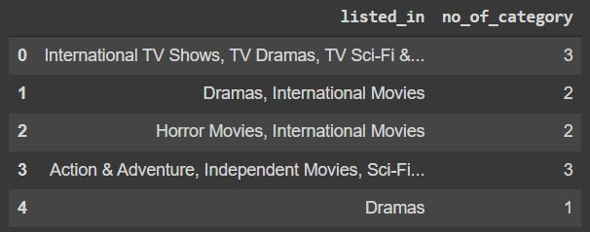
Data Cleaning
Removing unnecessary columns like 'director', 'cast'.
Dropping all the NaN containing date_added observations(Only 10 observations was there )
Created 4 new columns
No_of_categories based on listed_in
Date_added_month based on date_added

Slide 8
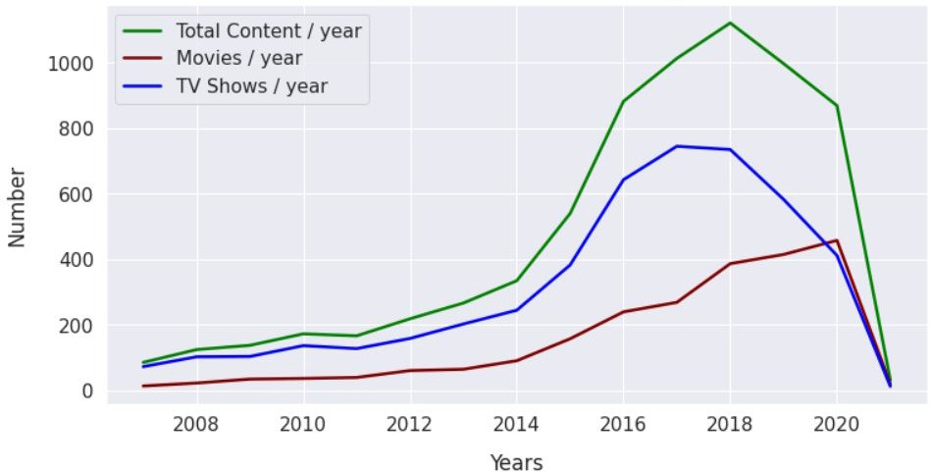
Production Yearly Growth
Can you say what’s the reason of that boom growth??

Slide 9
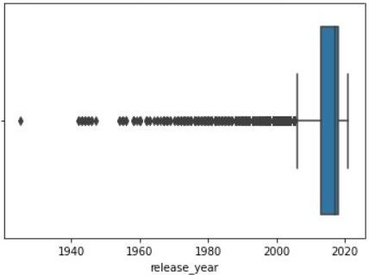
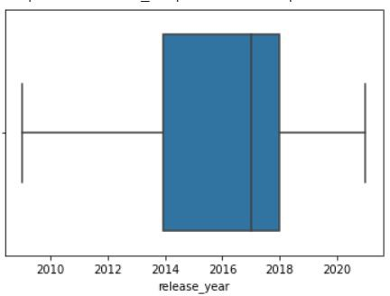
Checking Outliers
Replaced outliers values with mean value of release_year

Slide 10
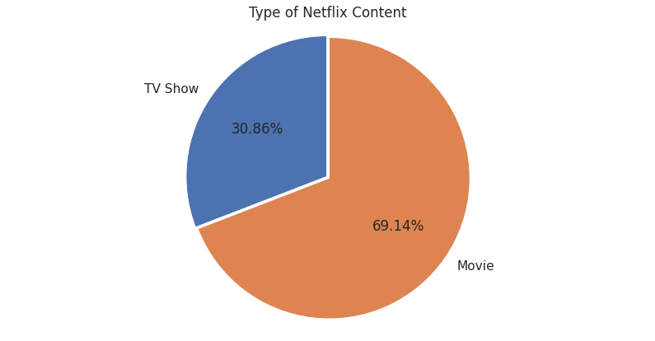
Tv shows or Movies ??
Most of the contents are Movies
Less than ⅓ content are Tv Shows

Slide 11
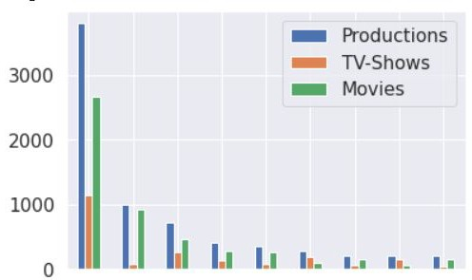
Countries Producing Most No Of Contents
Count
United
states
India United Canada France
Kingdom
Japan
Spain
^{South} Germany
Korea
United states have the most number of content and then india and so on
We can conclude that except Japan other countries are producing movies more than TV-Shows

Slide 12
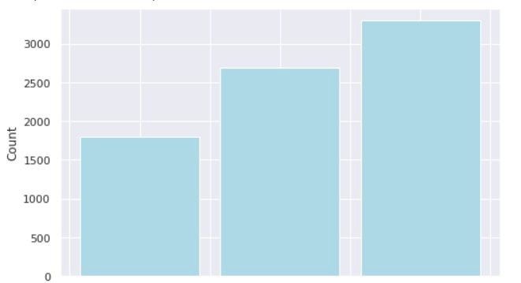
How many no of categories are present there in each content ?
1
2
no_of_category
3
Most of the movies are belonging to 3 categories

Slide 13
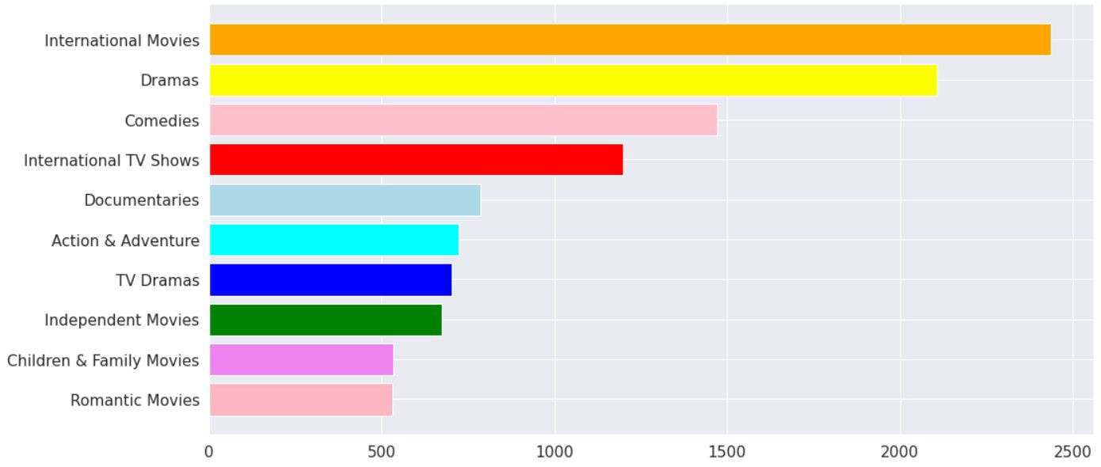
Top 10 Category For Contents

Slide 14
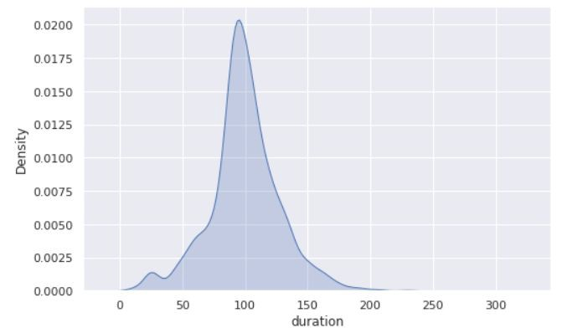
Movie Wise Density Plot
Most movies are about 70 to 120 min duration for movies

Slide 15
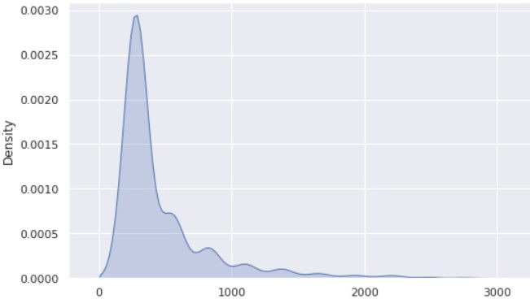
Tv-shows Wise Density Plot
duration
Most contents are about 0 to 750 min duration for Tv shows
There are very few shows which is having more than 1000 mins. (may be the no of episodes/ seasons are more)

Slide 16
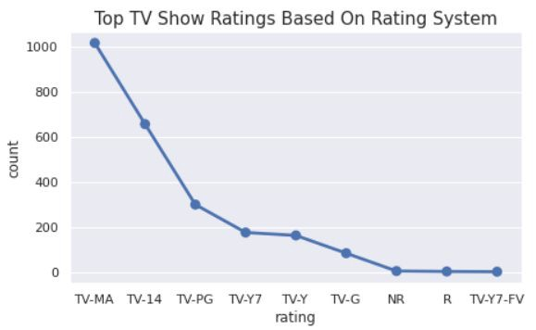
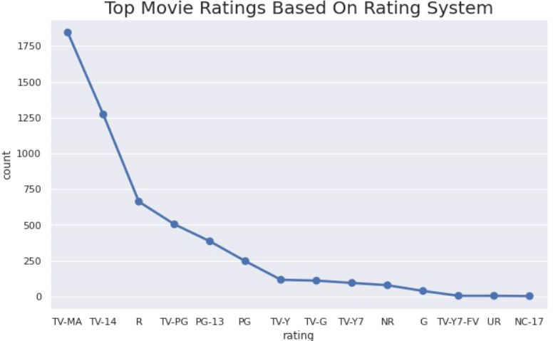
TOP Content Based On Rating
Most of the contents got ratings like
TV-MA (For Mature Audiences)
TV-14 ( May be unsuitable for children under 14 )
TV-PG ( Parental Guidance Suggested )
NR ( Not Rated )

Slide 17
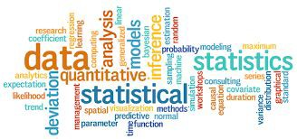
WordCloud
What Is a Word Cloud?
A word cloud (also known as a tag cloud) is a visual representation of words. Cloud
creators are used to highlight popular words and phrases based on frequency and relevance. They provide you with quick and simple visual insights that can lead to more in-depth analyses.
De
Example →

Slide 18
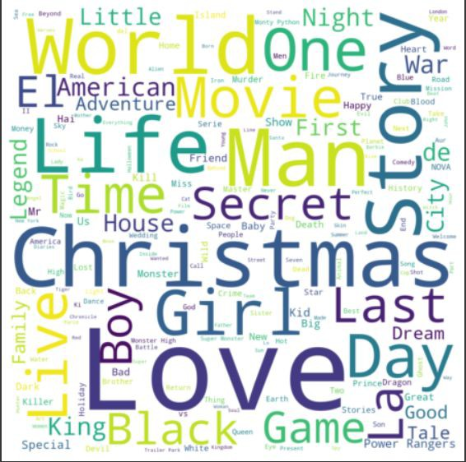

Applying WordCloud On Title
Most occurred words present in Title are:-
Love
Man
World
Story
Christmas
Girl
Day
Why Christmas occurred ?

Slide 19
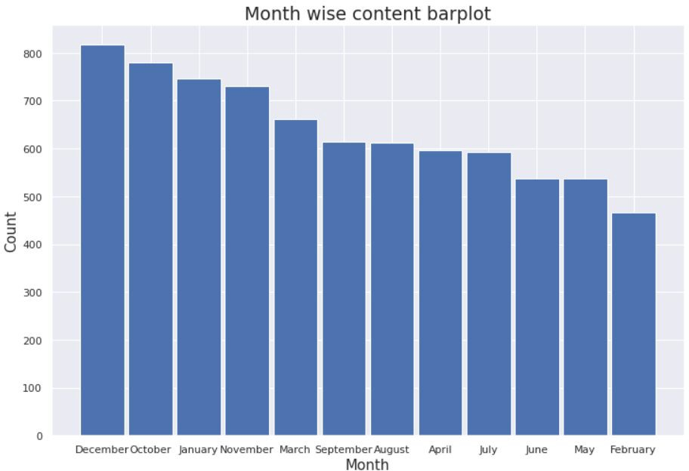
Barplot Based On Release Month
We can say that December is the holiday season and it also has Christmas, so in that month most of the content got uploaded.

Slide 20
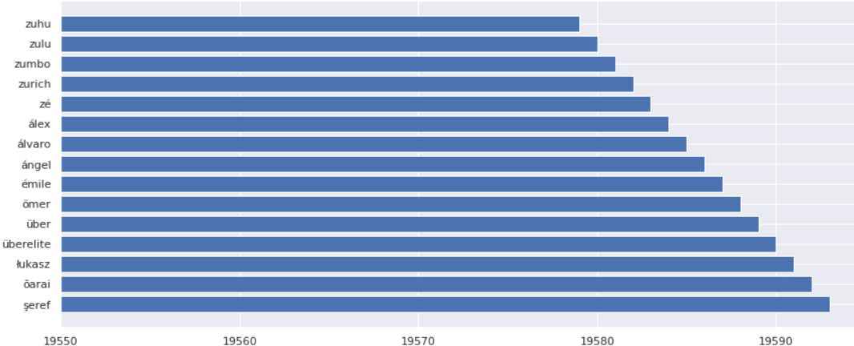
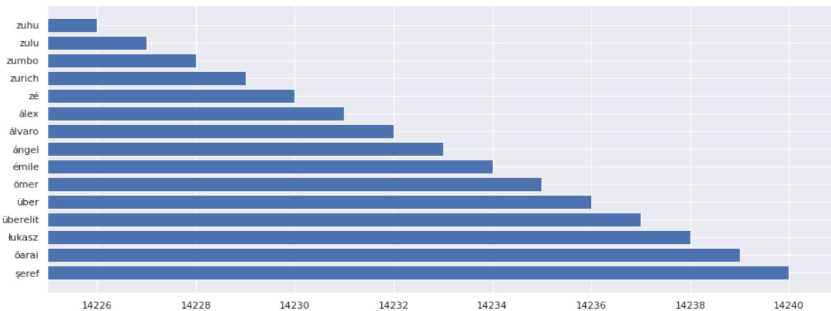
Before & After Stemming Most Occurred Words
In Description

Slide 21
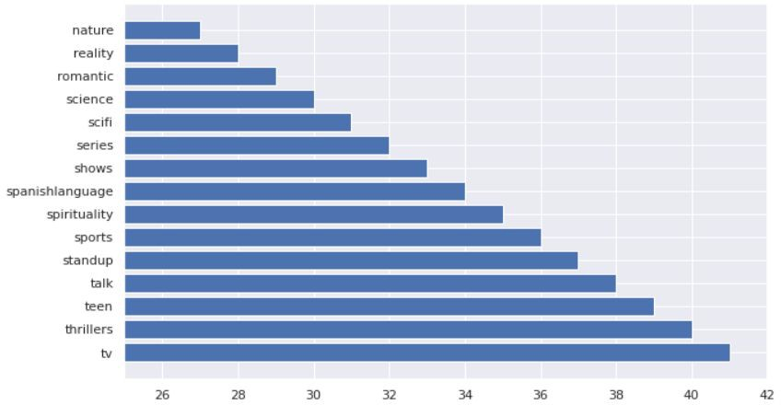
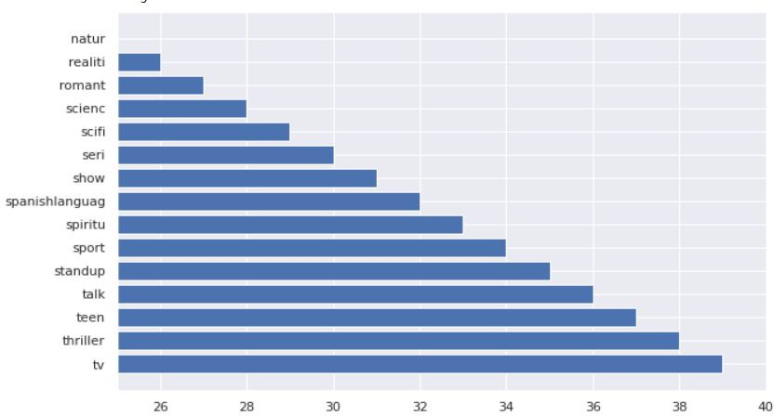
Before & After Stemming Most Occurred Words
In listed_In

Slide 22
Feature Selection & ML Algo Used
Only selected 3 features , to do clustering
no_of_category
Length(description)
Length(listed-in)
Using StandardScaler
Used 5 algo to find out best k value
1. Silhouette score
2. Elbow Method
3. DBSCAN
4. Dendrogram
5. AgglomerativeClustering

Slide 23
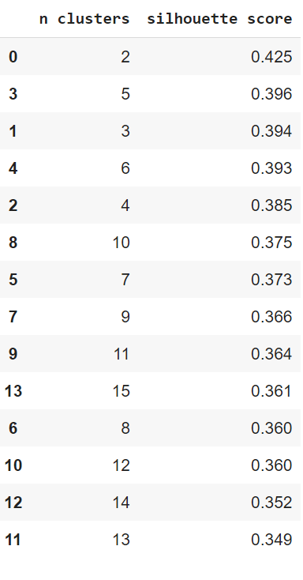

1. Silhouette Score
Silhouette Coefﬁcient Formula
mean intra-cluster distance(a):- Mean distance between the observation and all other data points in the same cluster.
●
mean nearest-cluster distance (b)
:- Mean distance between
the observation and all other data points of the next nearest cluster. This distance can also be called a.
The value of the silhouette coefﬁcient is between [-1, 1]
If score is 1 denotes the best meaning that the data point i is very compact within the cluster to which it belongs and far away from the other clusters.
The worst value is -1
If score is 0 denotes overlapping clusters

Slide 24
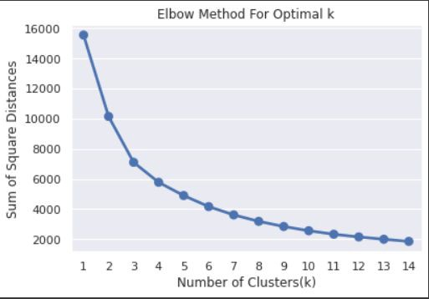
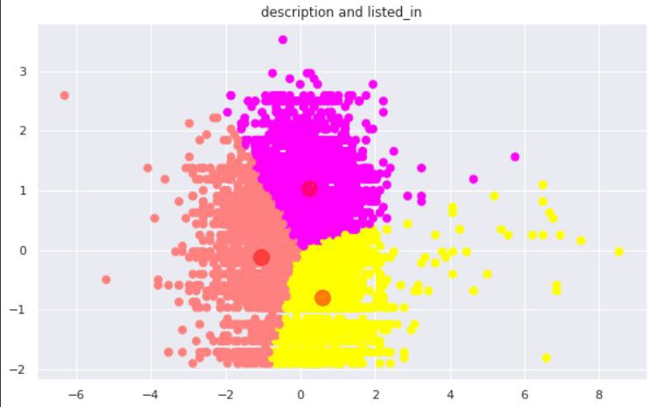
2. Elbow Method
The elbow method runs k-means clustering on the dataset for a range of values for k (say from 1-15) and then for each value of k computes WCSS value . By default, the distortion score is computed, the sum of square distances from each point to its assigned center.

Slide 25
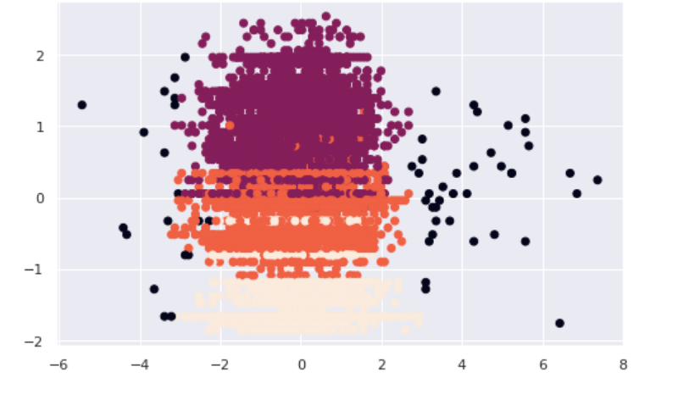
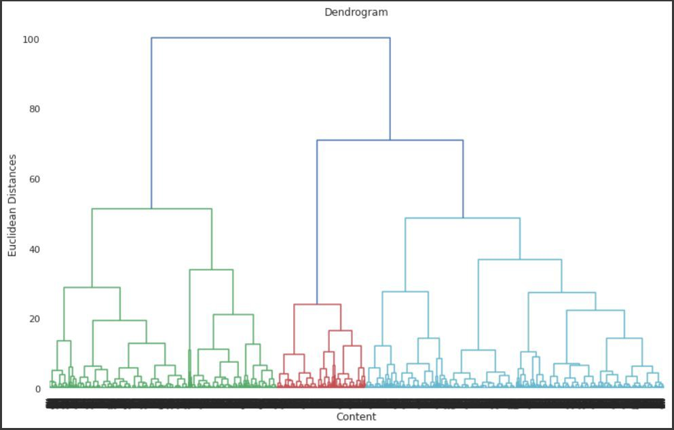
3 & 4 DBSCAN & Dendrogram
DBSCAN(Density-based spatial clustering)
the black dots denoted noise
Dendrogram

Slide 26
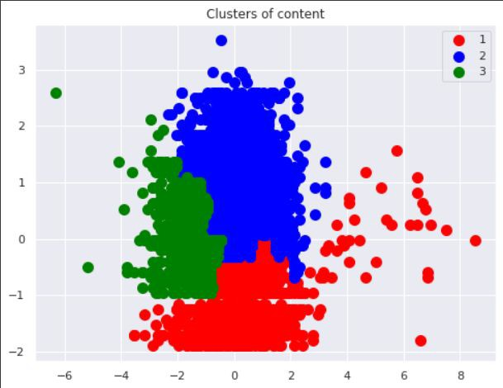
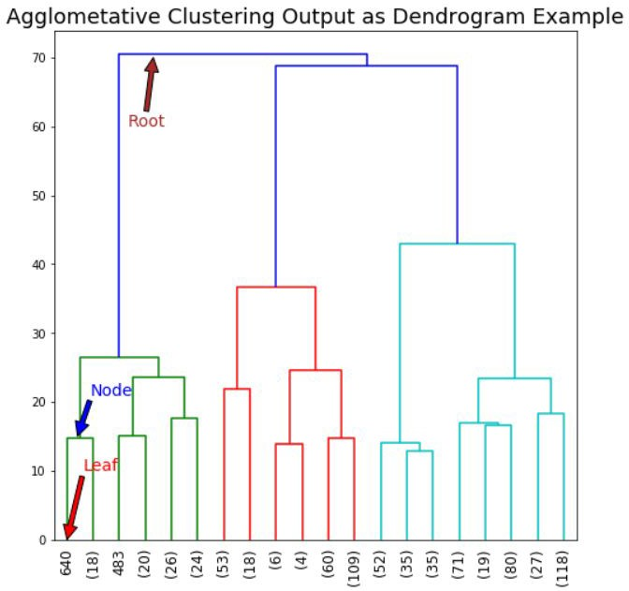
Agglomerative Clustering
Steps: -
Each data point is assigned as a single cluster.
Determine the distance measurement and calculate the distance matrix.
Determine the linkage criteria to merge the clusters.
Update the distance matrix.
Repeat the process until every data point become one cluster.

Slide 27
Conclusion
Director and cast contains a large number of null values so we will drop these 2 columns .
In this dataset there are two types of contents where 30.86% includes TV shows and the remaining 69.14% carries Movies.
We have reached a conclusion from our analysis from the content added over years that Netﬂix is focusing movies and TV shows (Fom 2016 data we get to know that Movies is increased by 80% and TV shows is increased by 73% compare).
From the dataset insights we can conclude that the most number of TV Shows released in 2017 and for Movies it is 2020.
On Netﬂix USA has the largest number of contents. And most of the countries preferred to produce movies more than TV shows.
Most of the movies are belonging to 3 categories.
TOP 3 content categories are International movies , dramas , comedies.
In text analysis (NLP) I used stop words, removed punctuations , stemming & TF-IDF vectorizer and other functions of NLP.
Applied different clustering models like Kmeans, hierarchical, Agglomerative clustering, DBSCAN on data we got the best cluster arrangements.
By applying different clustering algorithms to our dataset .we get the optimal number of cluster is equal to 3.

Slide 28


